Slide 1



Slide 2
When was the internet born?
A: 1990s
B: 1980s
C: 1970s.
D: 1950s

Slide 3
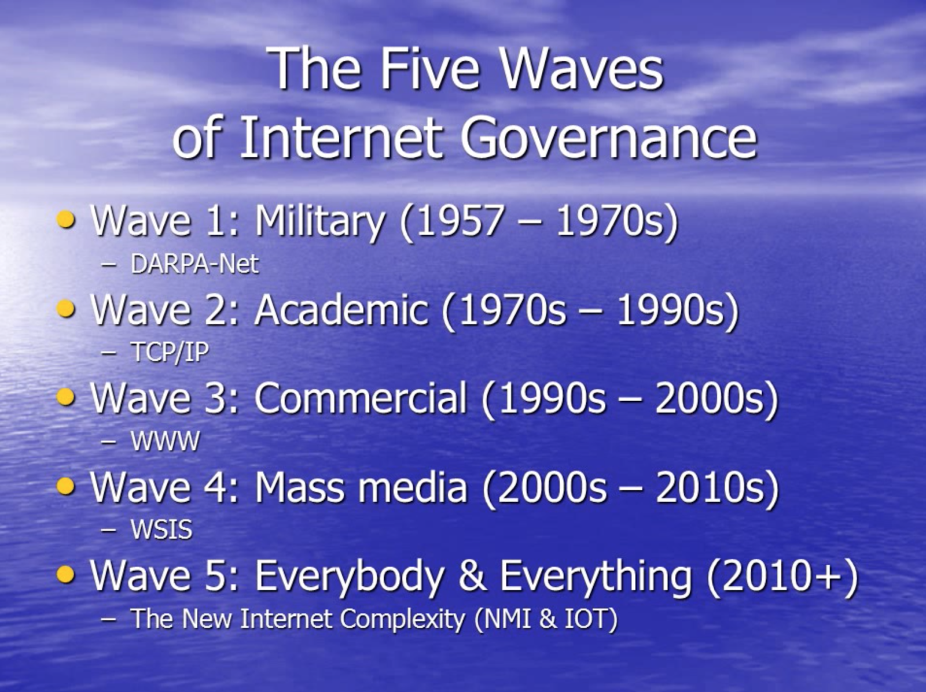
Wolfgang Kleinwächter

Slide 4
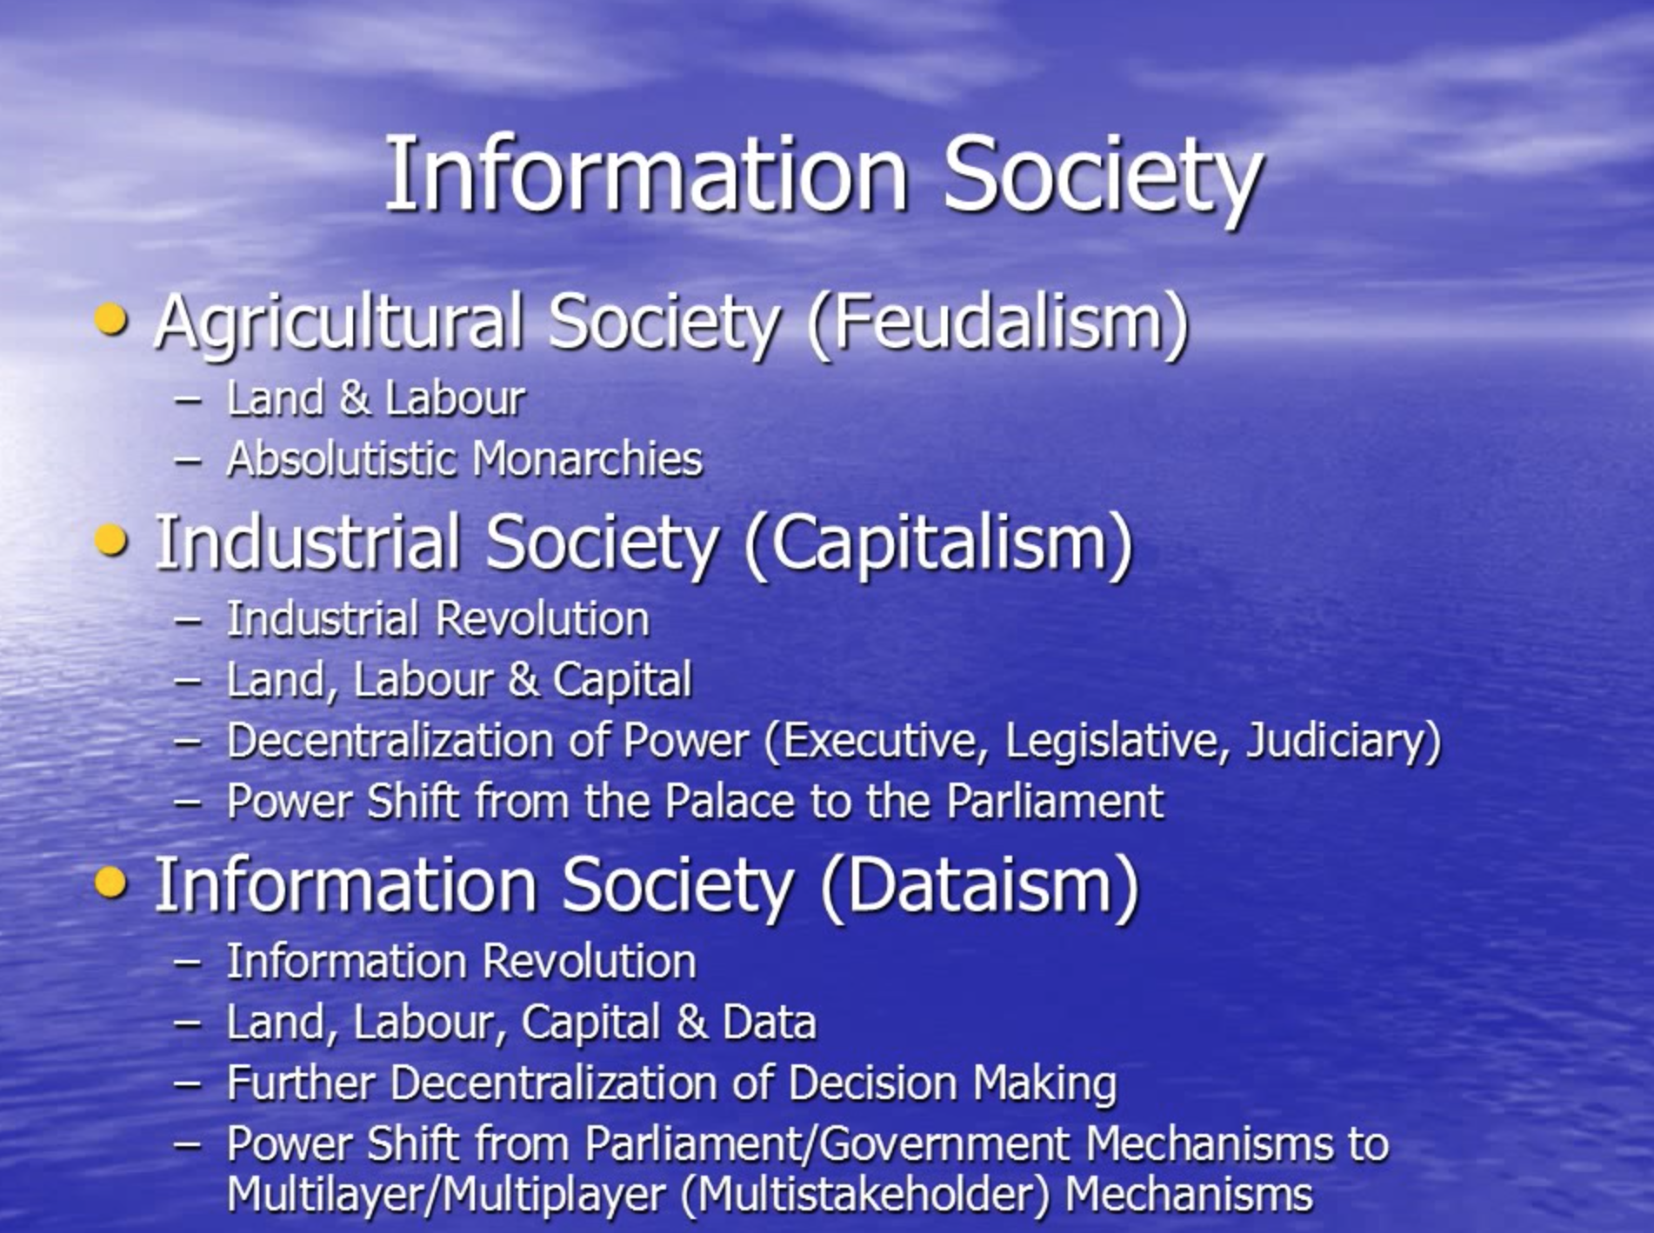
Alvin Toffler

Slide 5
Which is NOT correct on Internet Specifics
A: decentralised architectural
design
B: unlimited resources
C: Not regulated
D: Code on top of
the laws

Slide 6
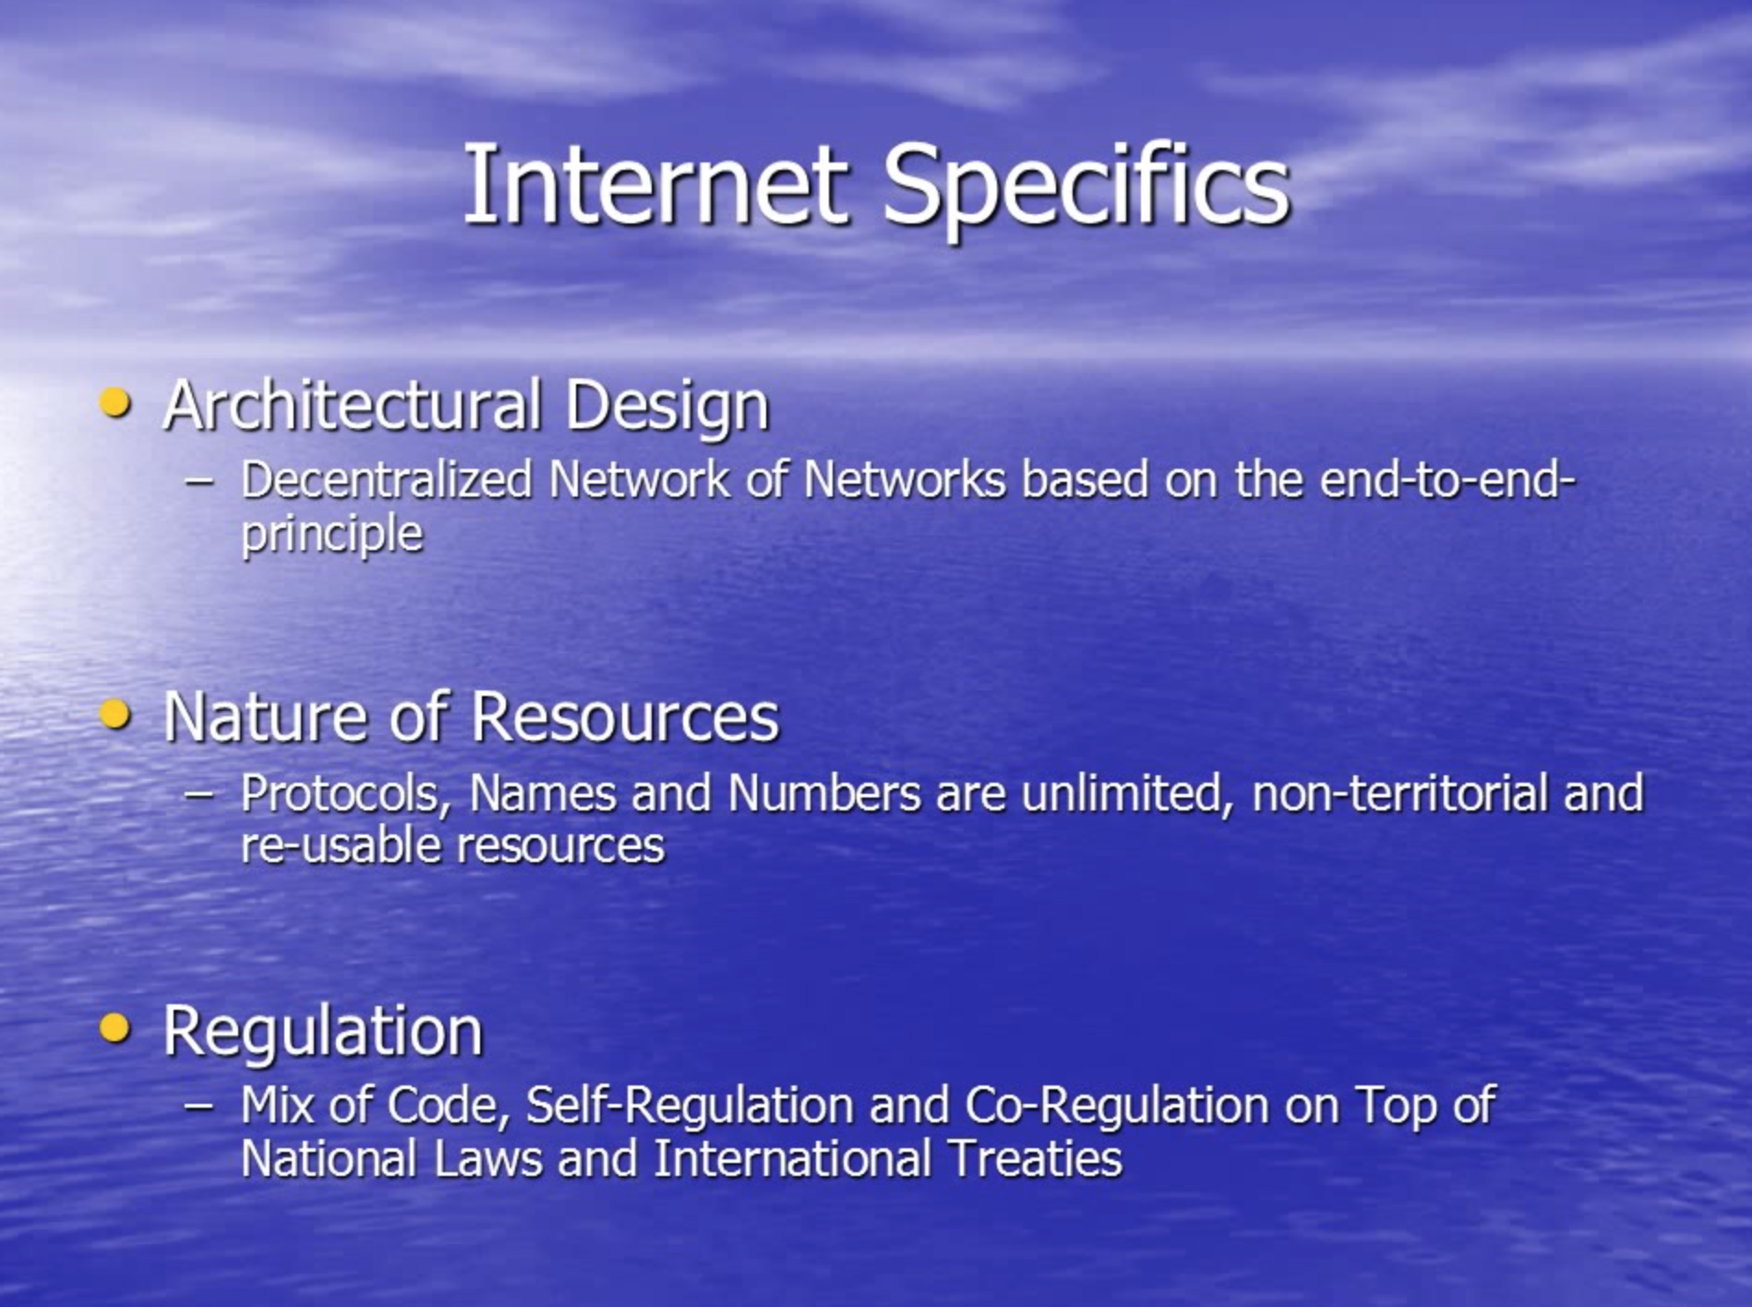

Slide 7
When scam users try to get a hold of your account and password information:
A: Naughty
B: Data breachers
C: Internet scammers
D: Phishing

Slide 8


Slide 9
What things are in the internet of things?
A: stuff that can be bought on the darkweb;
B: Making traditionally dumb physical devices and everyday objects smart
C: Artificial intelligence not involving humans
D. Solidified wifi waves

Slide 10


Slide 11
Please fill the gap: According the _______ principle, every point on the network can connect to any other point on the network, without discrimination on the basis of origin, destination or type of data.
A: General Data Protection Regulation
B: Anti-discrimination law
C: Net neutrality
D: Sexual Harrassment

Slide 12
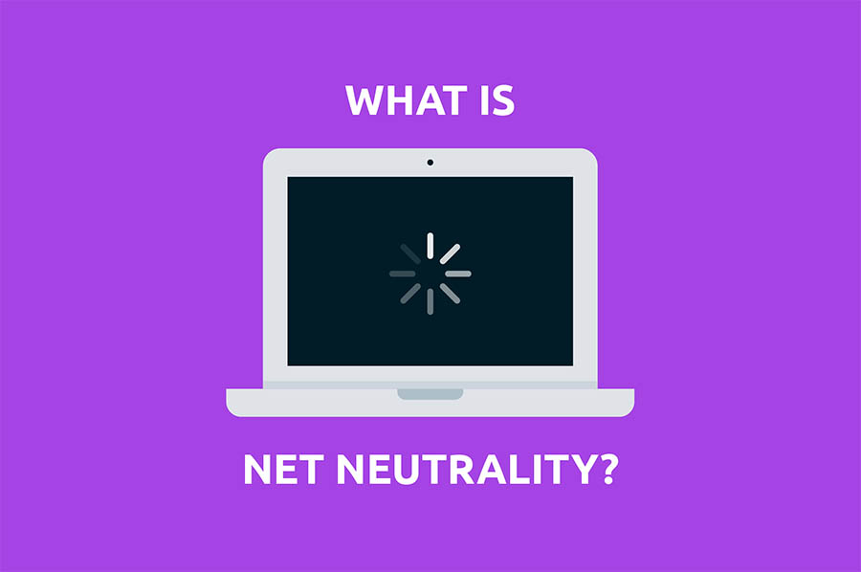

Slide 13
What obligations does General Data Protection Regulation bring to the companies that has EU citizen users?
A: The right to be forgotten
B: To notify the users about the data breach in 72hrs
C: Ask consent to retain the data;
D: Users can ask for
Access on their data;

Slide 14
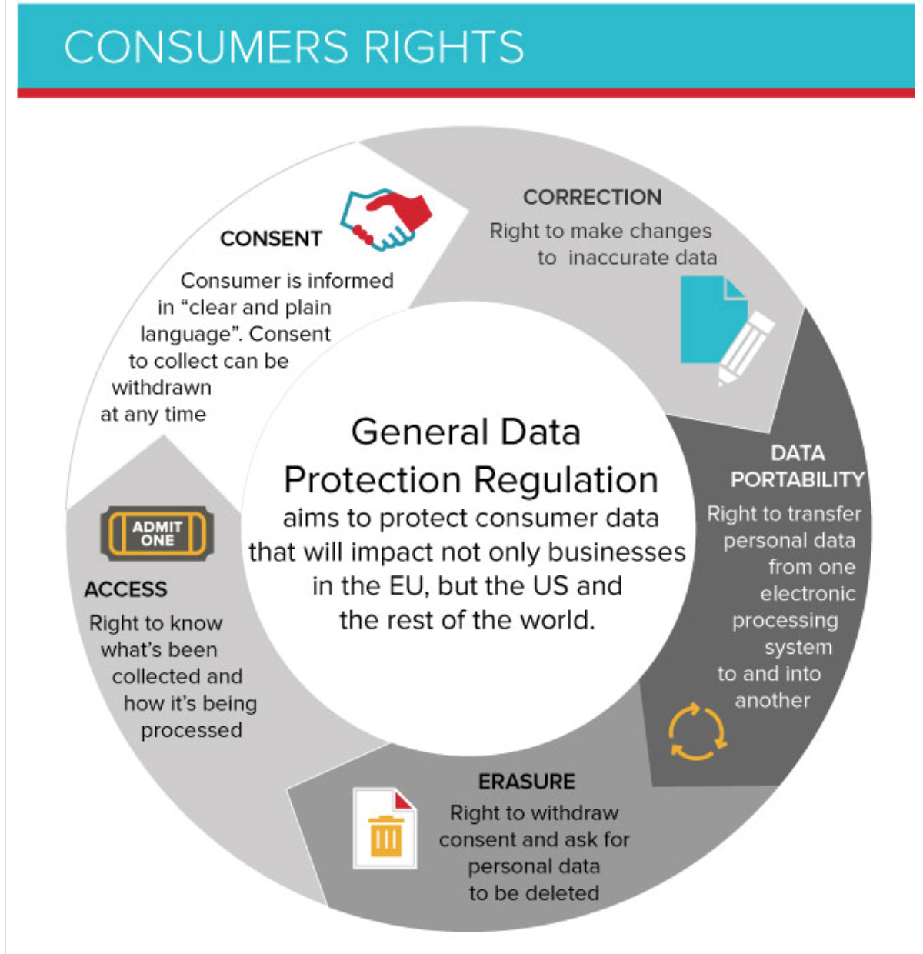

Slide 15
first international treaty on crimes committed via the Internet and other computer networks, dealing particularly with infringements of copyright, computer-related fraud, child pornography, hate crimes, and violations of network security
A: GDPR
B: International covenants on
Internet freedom
C: European Court on human rights in Strasbourg
D: Convention on cybercrime

Slide 16
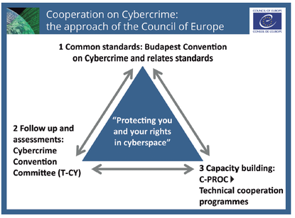

Slide 17
Which was the first country to legally guarantee right to access the Internet through a universal service legislation?
A: Germany
B: Estonia
C: Georgia
D: Finland

Slide 18
Which kind of content is EU code of conduct is not dealing with?
A: terrorist content
B: unhealthy propaganda
C: illegal hate speech
D: unsafe products

Slide 19

Common work and commitment;
Self-regulation;
Civil Society Empowerment and Participation;
Legislative Action;
Outreach and grassroots action.

Slide 20
Where is the next EuroDIG taking place
A: Space
B: Tbilisi
C: Berlin
D: The Hague

Slide 21
